Slide 1
Van Emde Boas Trees
Worked by: Alvi Hysa ………………… Engjëll Abazaj
………………… .Indrit Ferati

Slide 2
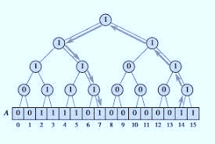
Overview
A van Emde Boas tree (vEB tree) is a tree data structure that implements a map with m-bit integer keys.
Key Features:
- Efficient operations: O(log log M) time complexity
- Not space efficient

Slide 3
Complexity Analysis
Universe Size: M = 2^m
Hierarchical Decomposition: Splits universe into smaller clusters for efficient operations
Summary Structure: Records clusters with elements for rapid queries
Recursive Operations: Successor, predecessor, insert, and delete in O(log log M) time
Practical Implications: Useful for applications needing fast order statistics on integer keys

Slide 4
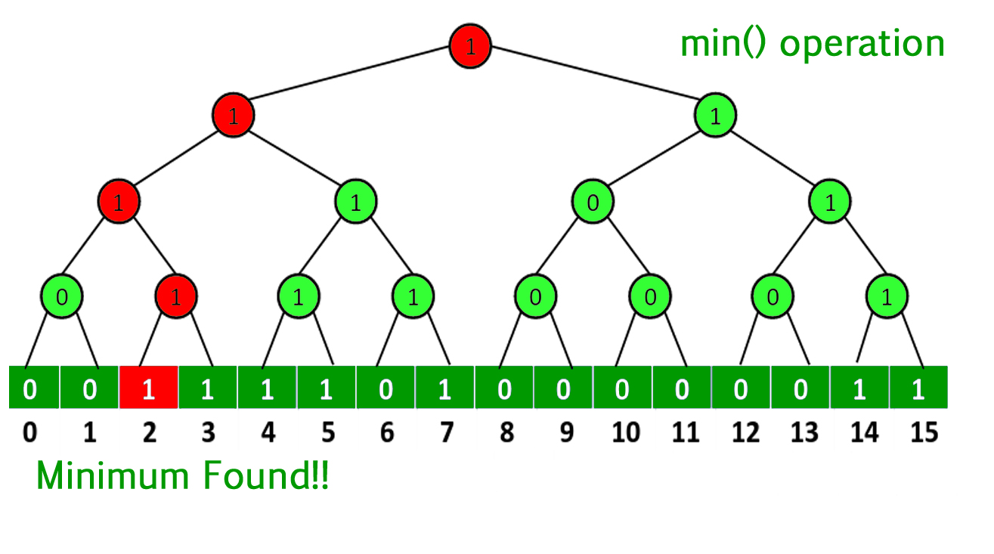
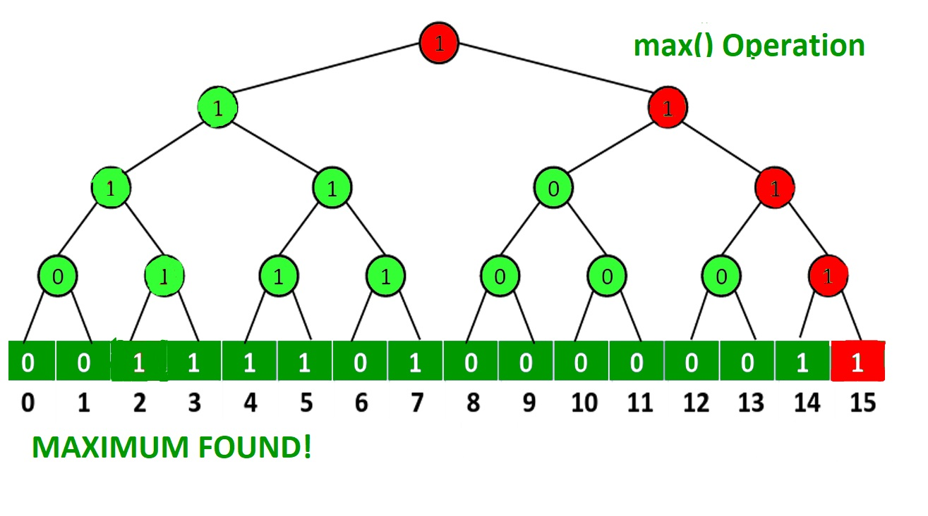
Supported Operations
Minimum: O(1)
Retrieve Minimum: The smallest element in the tree is always stored in the min property that the tree maintains.
Return Value: The min attribute's value is given back directly.
Maximum: O(1)
Retrieve Maximum: The largest element in the tree is always stored in the max property that the tree maintains.
Return Value: The max attribute's value is given back straight.

Slide 5
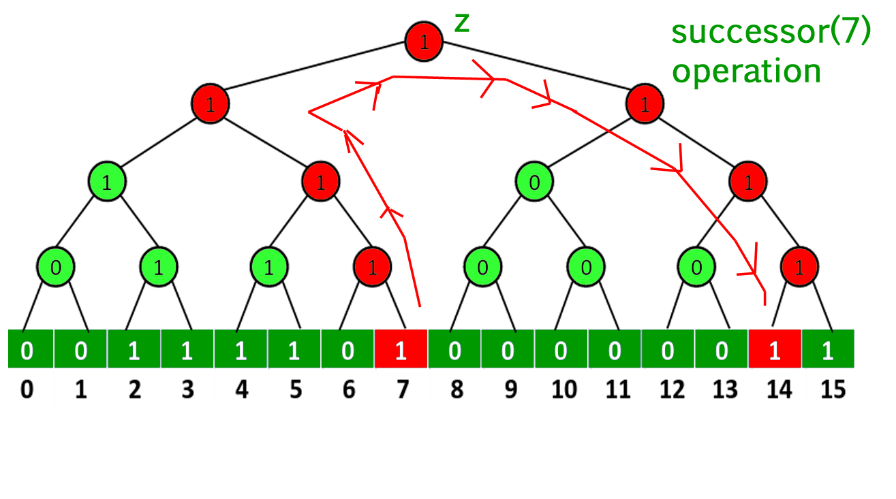
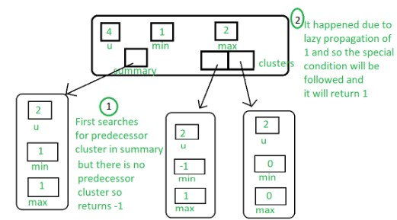
Supported Operations
Predecessor: O(log log M)
In a van Emde Boas tree, the precedingoperation determines the greatest element that is smaller than a specified element.
Successor: O(log log M)
In a van Emde Boas tree, the successor
operation determines which element is
the smallest element greater than a given element.

Slide 6
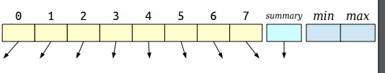


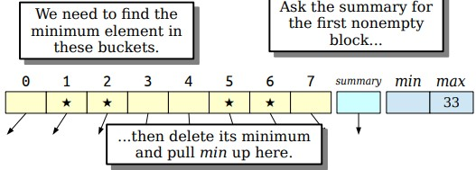
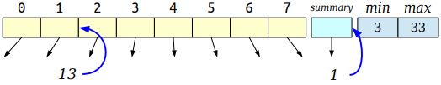

Supported Operations
Insert: O(log log M)
Recursively inserting the element into
successively smaller subtrees (clusters)
and updating auxiliary structures (summaries)
to maintain the correct minimum and maximum
values at each level are the steps involved
in the insertion process in a van Emde Boas tree.
Delete: O(1)
In a van Emde Boas tree, the deletion
operation is made by iteratively deleting
the element from the relevant cluster
and updating auxiliary structures (summaries)
to reflect the modification.

Slide 7
Variants and Extensions
X-Fast Tries:
Combines hash tables and trie structure
O(n log M) space
Y-Fast Tries:
Combines x-fast tries and balanced BSTs
O(n) space
Fusion Trees:
Uses word-level parallelism
O(log_a n), O(n) space

Slide 8
Comparison with other data structures
Binary Search Trees:
Faster query times but higher space complexity
Hash Tables:
Maintain order statistics; slower membership queries
Balanced Trees:
Faster query times for large universes but higher space …..complexity

Slide 9

Advantages & Applications
.
Advantages
Efficient for large-scale applications
Suitable for dynamic sets, priority queues, and databases
Useful for successor and predecessor searches
Applications
Databases
Graph algorithms
Cryptography

Slide 10

Conclusions
.
Strengths
O(log log M) time complexity for various operations
Trade-offs
High space complexity (O(M))
Practical implementations often use variants for better space efficiency
Importance
Significant in data structure theory for efficient integer key operations

Slide 11
THANK YOU FOR YOUR ATTENTION!

